Slide 1
Is Everything in Order? A Simple Way to Order Sentences
https://github.com/fabrahman/ReBART.
emnlp-2021
Reported by Dongdong Hu

Slide 2
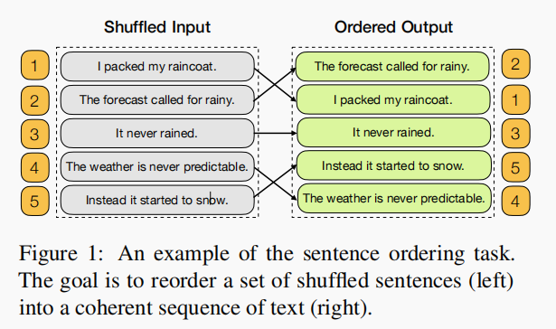
Introduction

Slide 3
Introduction
We formulate the sentence ordering as a conditional text generation problem and present a simple method to solve it.
We conduct zero-shot evaluations showing our model trained on Movie Plots outperforms the previous in-domain trained state-of-the-art.
We present a thorough analysis to evaluate sensitivity of our model to different input properties.
Notes:
A line of work have leveraged neural networks to encode sentences and retrieve the fifinal order using pointer network
Other works considered reframing the task as a ranking problem
We solve the sentence ordering task using a text-to-marker framework

Slide 4
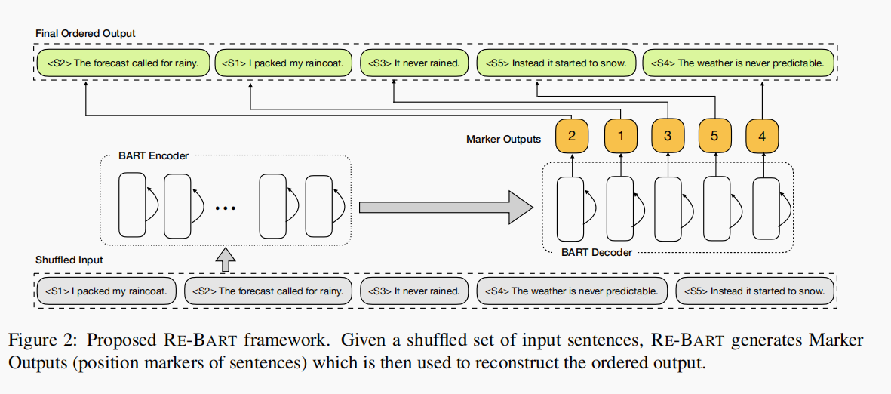
Method

Slide 5
Method
Input sentences
position markers
reconstructed sentences
Notes:
A line of work have leveraged neural networks to encode sentences and retrieve the fifinal order using pointer network
First, the model performs better as the output space is much smaller.
Second, text-to-text framework often generates text which is not part of the input

Slide 6
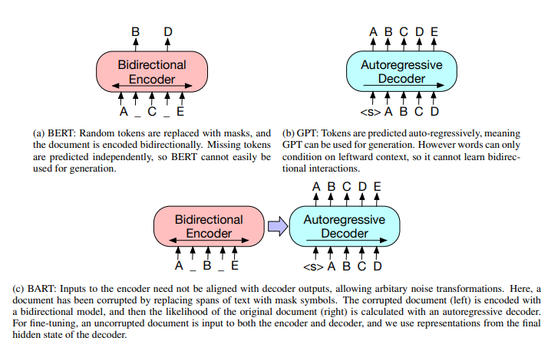
Method
BART模型在预训练时，首先使用多种噪声对原始文本进行破坏，然后通过seq2seq模型重建原始文本。
Notes:
Bart 有用句子排列目标进行预训练。

Slide 7
Method
Notes:
Bart 有用句子排列目标进行预先训练。

Slide 8
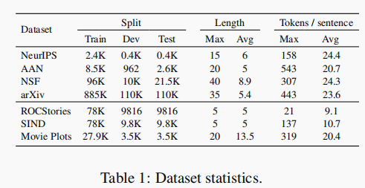
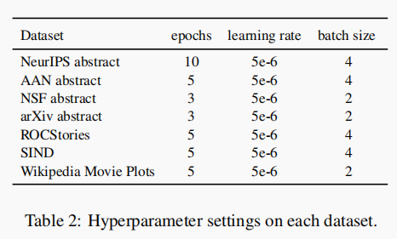
Experiments
Notes:
we fine-tune a pre-trained BART model to generate the text sequences
corresponding to sentences instead of their markers

Slide 9
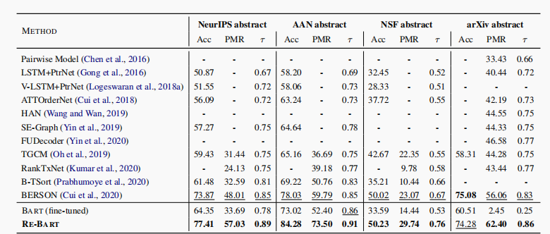
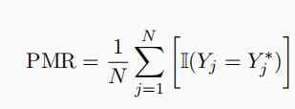
Experiments
Notes:
we fine-tune a pre-trained BART model to generate the text sequences
corresponding to sentences instead of their markers

Slide 10
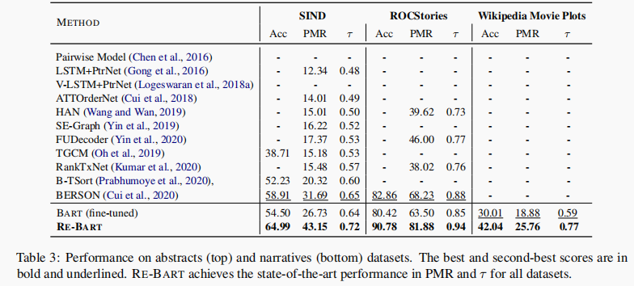
Experiments
Notes:
BART (fine-tuned) performs reasonably well on the
NeurIPS, AAN, SIND and ROCStories datasets
where the average number of sen
tences (Table 1) is low. It struggles on
NSF, arXiv and Movie Plots
where input sequences are longer.

Slide 11
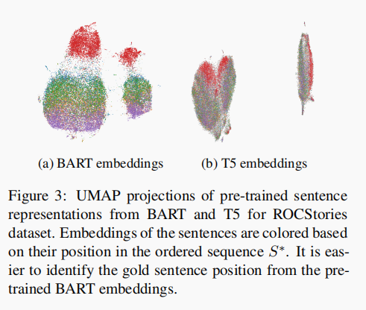
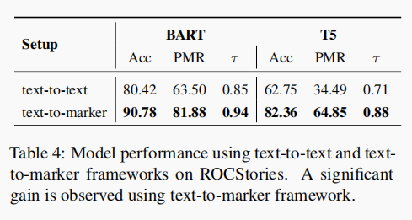
Experiments
Notes:
Text to marker 结构能普遍提高bert 和 T5 序列到序列模型，说明时text to marker结构而不仅仅只对bart起作用
例如，红色表示每个实例的第一个句子，在BART的情况下，属于相同输出位置(si)的句子嵌入在空间上聚类得更好，这使得它们更容易被识别

Slide 12
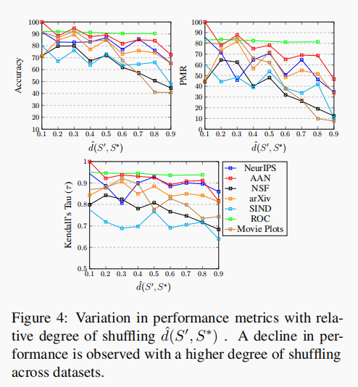
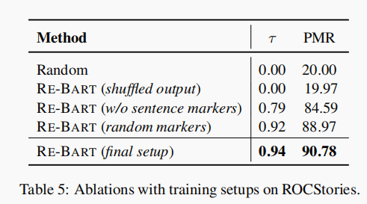
Experiments
Notes:
把所有的标记中的5全部改为1，来训练模型，模型在的时候能够学到句子之间的语义信息，所以会判断错误，而不仅仅是拟合数据。
拿错误的标签作为模型的输出，得到随机的结果，而不是说模型只关注数据和标签的对应的关系。
在第一个消融测试中，我们想要验证该模型是能够捕获句子之间的一致性，还是只是对数据的过拟合。
混乱度对排序的影响

Slide 13
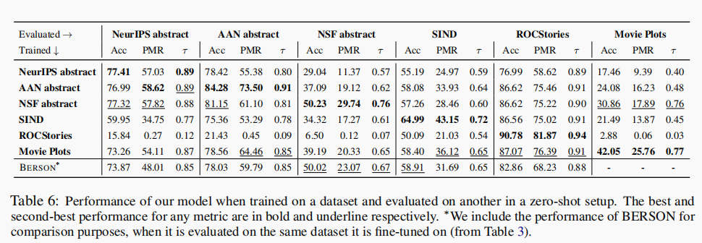
Experiments

Slide 14
Experiments
Notes:
句子数量的影响

Slide 15
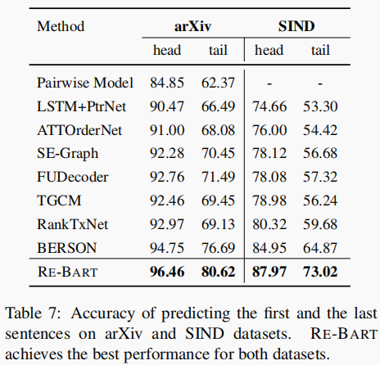
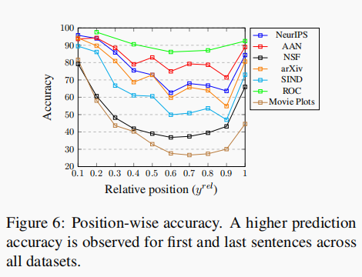
Experiments
Notes:
第几个相对位置的准确率
前四个都是摘要数据集 有模式
后三个故事数据集

Slide 16
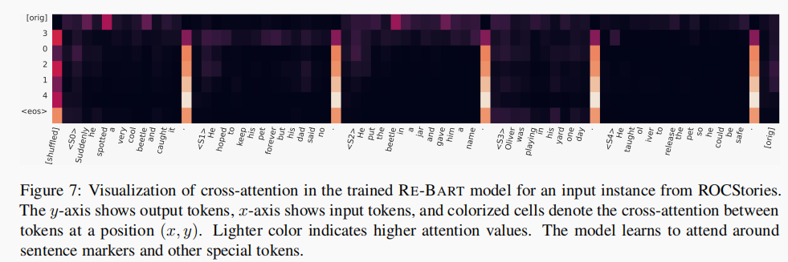
Experiments

Slide 17
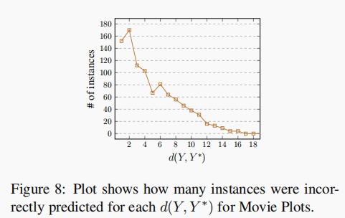
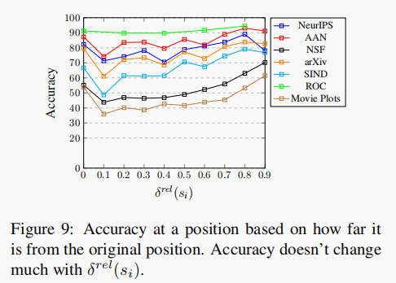
Experiments
Notes:
排序结果是基本排对了，需要交换的次数少
图8，横轴恢复到正常次序需要的最小次数，纵轴是movie plot样例的个数
交换距离对排序的影响

Slide 18
Thanks

